Slide 1
UTERUS CANCER IDENTIFICATION
Synergy Sharks |Nandha Engineering College

Slide 2
Description
Deep Learning Techniques: Utilizes convolutional neural networks (CNNs) and other advanced architectures to analyze medical images for detecting uterine cancer.
Data Processing: Preprocessing steps include noise reduction, normalization, and segmentation of relevant areas in imaging modalities like MRI or histopathology slides.
Training and Learning: Models are trained on annotated datasets to identify patterns and features unique to cancerous and healthy tissues.
Evaluation Metrics: Accuracy, sensitivity, specificity, and F1-score are used to measure model performance and reliability in diagnosis.
Clinical Application: Enables early, non-invasive detection and aids in precise diagnosis, potentially improving patient outcomes and treatment planning.

Slide 3
Project Goals
Automation:
Design a deep learning model to automate the detection and classification of uterine cancer from medical imaging data.
Accuracy:
Achieve high diagnostic accuracy by leveraging advanced neural network architectures and optimized training techniques.
Early Detection:
Enable early and reliable identification of uterine cancer to improve patient outcomes and survival rates.
Clinical Support:
Provide a tool to assist clinicians in making faster and more precise diagnoses for effective treatment planning.

Slide 4
Project Implementation:
Data Collection and Preprocessing:
Gather and preprocess medical imaging data (e.g., MRI, histopathology) with necessary steps like noise reduction, normalization, and segmentation for better model input.
Model Development:
Select and implement a deep learning architecture (e.g., CNN) for detecting cancerous features in images, incorporating data augmentation techniques to improve model robustness.
Model Training and Evaluation:
Train the model using labeled datasets, then evaluate its performance with metrics such as accuracy, sensitivity, and specificity, ensuring reliable results.
Deployment and Validation: Deploy the trained model into a clinical setting for real-world testing and validation, optimizing based on feedback from medical professionals for practical use.

Slide 5
Type of Neural Network Used:
Convolutional Neural Networks (CNNs) :
It is a type of deep learning architecture specifically designed for processing and analyzing image data.
Key Components of CNNs:
Convolutional Layers: Extract features using filters.
Pooling Layers: Reduce dimensionality.
Fully Connected Layers: Combine features for classification.

Slide 6
Frameworks used:
TensorFlow:
A popular open-source framework developed by Google, offering a flexible and scalable platform for building and training deep learning models.
Keras:
A high-level API built on top of TensorFlow or Theano, providing a simplified interface for building and training deep learning models.

Slide 7
Activation Functions:
ReLU (Rectified Linear Unit):
f(x) = max(0, x)
Relu is simple and computationally efficient.
It helps prevent the vanishing gradient problem.
It is used in hidden layers.
Sigmoid:
f(x) = 1 / (1 + e^(-x))
It produces outputs in the range of 0 to 1.
It is used in output layer .

Slide 8
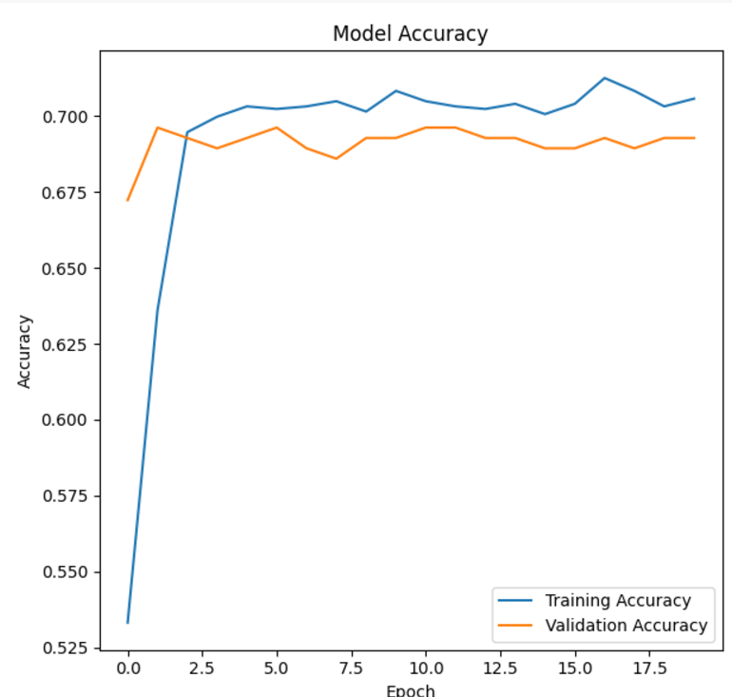
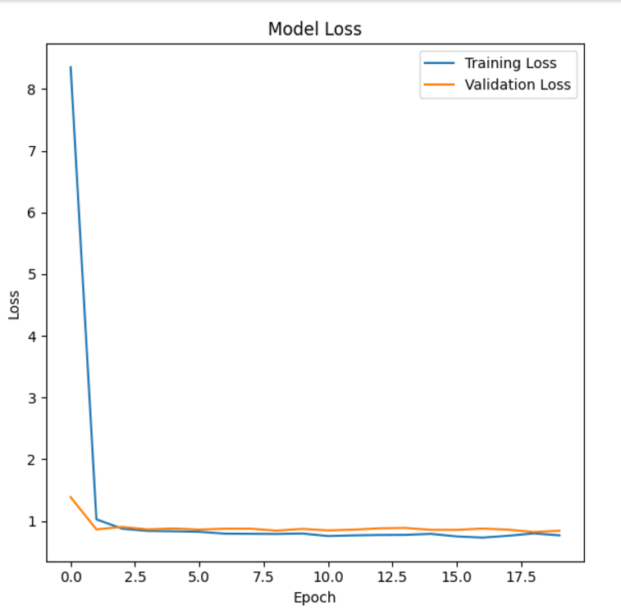
Accuracy & Loss Graph

Slide 9
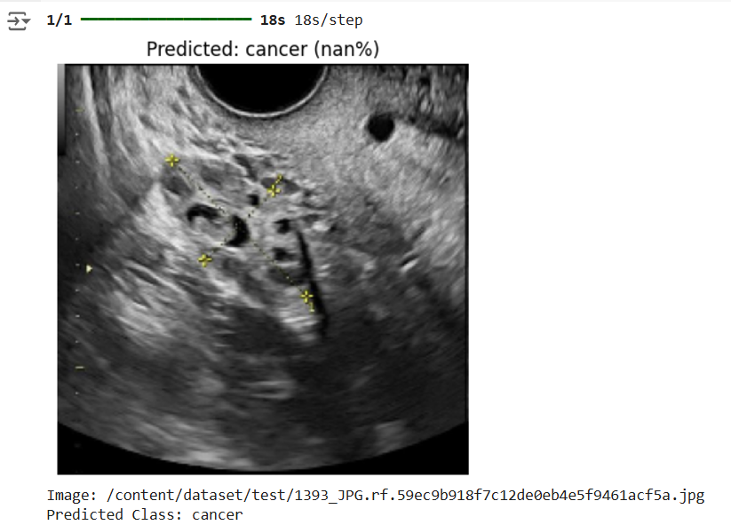
Output

Slide 10

THANK YOU

